Slide 1
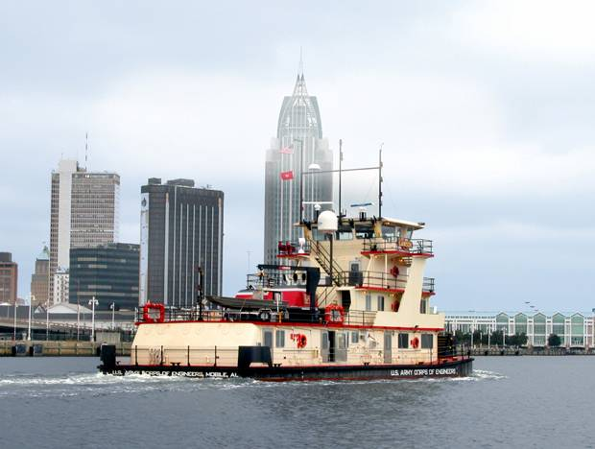
SAME Jacksonville Post Industry Day
Mobile District Program
04 Dec 2018
LTC Patrick Yoder
Deputy District Commander

Slide 2
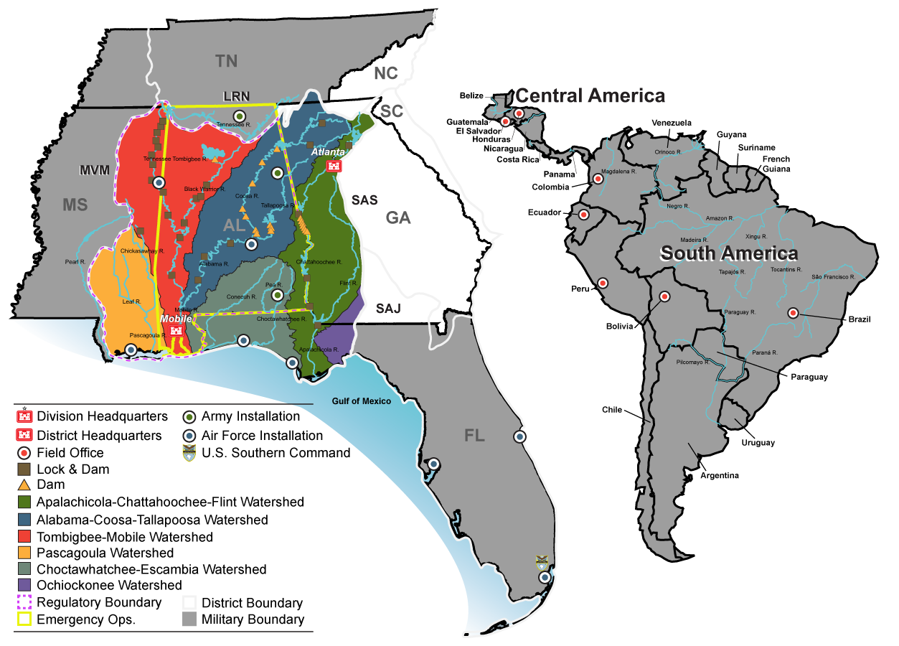
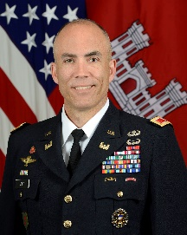
Mobile District
Area of Operations
Colonel
Sebastien Joly
Commander and District Engineer
Mobile District
District Facts:
Established in 1815, the Mobile District employs 1,100 civilian personnel and approximately 10 military officers with a presence that covers the states of Alabama, Florida, Georgia, Mississippi as well as all Central and South America. The Mobile District manages a $1 billion Military, Civil Works, and International/Inter-agency Support program that responds to disasters, manages water resource infrastructure, protects the environment, and provides facilities for our national defense and inter-agency partners.
The Civil Works mission includes the operation and maintenance of six major river systems providing over 2,200 miles of navigation, seven deep-water harbors, 21 shallow draft ports, and flood control with over 67 projects that have prevented in excess of $200 million in flood damages over the last ten years. The District’s eight hydropower facilities generate 2.06 billion kilowatts of electricity and return $44.8 million of the U.S. Treasury. Mobile also manages one of the largest recreation programs in the Federal government with 27 lakes and 464 recreation areas averaging more than 34.1 million visitors a year.
Mobile District provides project management, construction, and engineer services to support the Department of Defense Military Construction, International support to U.S. Southern Command (SOUTHCOM), and Inter-Agency Support to NASA, FBI and other federal agencies. The District also provides engineering studies and other technical assistance such as master planning, environmental management and real estate support.
Notes:
7 states, 14 Senators & 20 Representatives
TN and CU basins…unique in that we share water resource mission w/TVA in the TN valley
740+ team members…260+ in Nashville
Full service CW district
Strong CG program
Flood Risk Management Projects
Wolf Creek Dam Seepage
Center Hill Dam Seepage
Navigation Projects
KY Lock
Chickamauga Lock
Large O&M program, multi-purpose projects, strong recreation, most of the hydropower assets in LRD
Regulatory Program
Emergency Response
Planning Program – to meet water resource needs of cities like Nashville as well as smaller communities such as Crossville

Slide 3



















Major Business lines - $1.3B/Year Program
Military Construction & SRM
(MILCON)
Program:
FY17 - $600M
FY18 - $519M
FY19 - $800M (Estimated)
7 Army Installations
(Rucker, Redstone, Anniston, 7th Grp, MS AAP,
SOUTHCOM Garrison, Soto Cano AB)
10 Air Force Installations
(Eglin, Hurlburt, MacDill, Homestead, Tyndall,
Duke, Columbus, Maxwell, Arnold, Gunter)
Notable Projects:
  MEDCOM MST ($250M/yr)
  Advanced Munitions ($75M) – Eglin AFB
  ERDC HQ ($52M) – Vicksburg
International and
Interagency Support (IIS)
Program:
FY17 – $112M
FY18 – $400M
FY19 - $150M (Estimated)
3 NASA Space Centers
(Stennis, Marshall, Kennedy)
Notable Projects:
  VA Bed Tower ($175M) – Tampa, FL
  NASA Standard Launch System Rocket Test Stands ($67M) – Huntsville, AL
  NAMRU-6 ($22M) – Lima, Peru
Civil Works
(CW)
Program:
FY17 – $328M
FY18 – $359M
FY19 – $300M (Estimated)
FY19
GI -- $9M (4 Feasibility Studies)
O&M -- $183M (All Business Lines)
CG - $2.9M (CAP)
GR - $4.5M
FCCE - $130M (MSCIP)
Notable Projects:
  Mobile Harbor, AL GRR
  Coastal Resiliency Program
  ACT Reallocation Study
  Supplemental Feasibility Studies

Slide 4
Mobile District Program Trends and Observations
-Priorities: Deliver the Program, Revolutionize Delivery
-Big business, one of USACE’s largest and most diverse programs (>$1B/year); growing military
program, in particular at Eglin AFB, Redstone Arsenal, ANAD, and Hurlburt
-Growing environmental workload, capturing more within our AOR; doing less outside our AOR
-Reimbursable work largest share of program (MEDCOM, environmental, SRM)
-Reliance on standing contracts…AE IDIQs, construction MATOCS/SATOCs, MEDCOM MATOCS,
REAT & BUILDER contracts; Mobile needs to replace many in the next 12-18 months
-Tyndall AFB Recovery

Slide 5
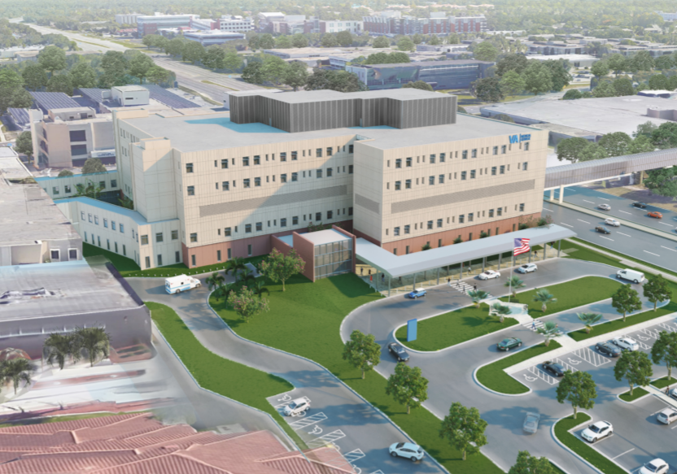
Mobile District key Projects/Hot Topics
VA Bed Tower, Tampa FL
Mobile Harbor General Reevaluation Report
Supplemental General Investigations Studies
  Proctor Creek, Atlanta GA
  Okaloosa, Okaloosa FL
  Selma Al
  Valley Creek, Birmingham AL (Kansas City District leads effort)
Workload (Eglin AFB, Hurlburt Field, Redstone Arsenal, Anniston Army Depot)
VA Bed Tower Addition
James A Haley VA Medical Center

Slide 6
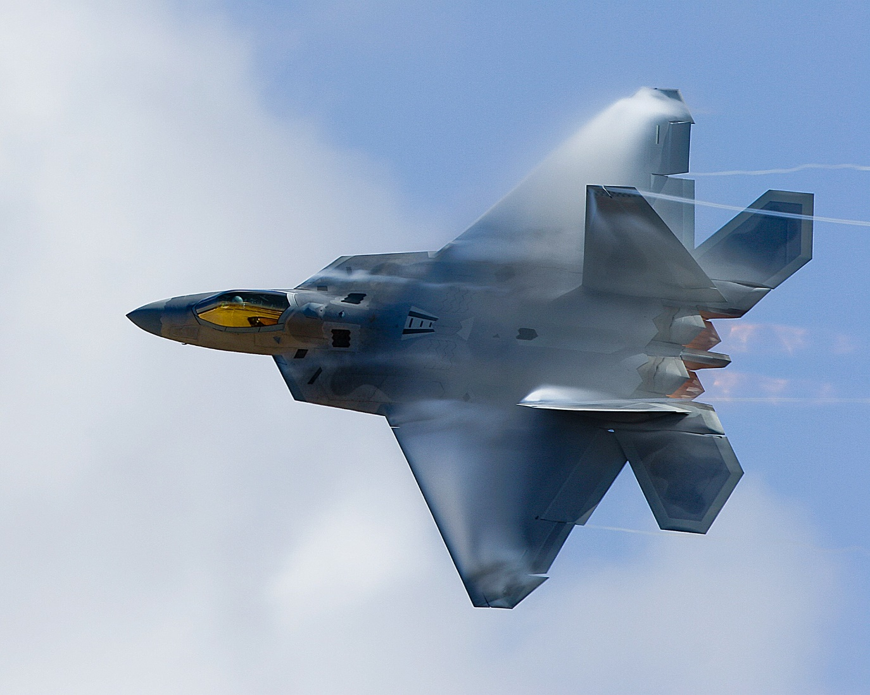
TYNDALL AFB Response & Recovery
AF Initial Response
  -TF Phoenix
  -AFCAP
USACE Support:
  -Initial Bldg Assessments
  -Temp Roofing
  -TF Hammer
  -AE TOs for D-B Repairs
  -Modular Buildings
  -FEST Team Deployment
Long Term Recovery

Slide 7
A-E Brooks Acts Opportunities – NAICS 541330
Mobile District AOR
Project | Set-Aside Category | Est. Award Value | Projected Advertise Date
AE Services Environmental HTRW & EQ (Interim REAT Replacements) | HTRW - $45M UR, $4M SBSA EQ – TBD | $49M HTRW $49M EQ | 2d Qtr, FY19
AE Services Engineering & Environmental Military & Civil (REAT Replacement - Compliance & HTRW) | $210M UR $40M SBSA | $250M | 2d Qtr, FY19
AE Services Planning & Environmental Division Military & Civil Works (REAT Replacement - NEPA/Master Planning) | $210M UR $40M SBSA | $250M | 2d Qtr, FY19
AE Services Military Design | TBD | $99M | 2d Qtr, FY19
AE Services – Design of Consolidated Test Center, Redstone Arsenal (SATOC) | UR – Stand Alone “C” Contract | $49M | Dec 2018
Notes:
First two procurements - AE services for Planning/Engineering Environmental will be replacement contracts for current REAT. Area of responsibility will be Mobile District vice current contracts for SAD AOR. Other districts in SAD may borrow capacity.
Last two procurements are interim REATs. First to advertise will be Planning Environmental.

Slide 8
A-E Brooks Acts SATOC Opportunities – NAICS 541330
Mobile District AOR
Project | Set-Aside Category | Est. Award Value | Projected Advertise Date
AE CMS | $24M UR $7M SBSA $5.5M one each 8(a) & SDVOSB | $49M | Jan 2019
AE Horizontal Civil Geotechnical MILCON | $6.9M UR $3M SBSA | $9.9M | Apr 2019
MEDCOM AE | TBD | $49M | 1st Qtr, FY20
Notes:
Future date to advertise AE Military Design solicitation will rely on remaining capacity which will be reviewed after 1 Oct 2018.

Slide 9
Construction
NAICS 236220 (unless otherwise noted)
Project | Set-Aside Category | Est. Award Value | Projected Advertise Date
MEDCOM Western Region 2 Phase D-B MATOC | UR SBSA | $249M | 1st Qtr, FY20
Military Construction North/South Regions Mobile District AOR 2 Phase D-B MATOCs | $245M (2) UR $200M (2) SBSA | $845M | Presolicitation Notices posted now for UR W91278-18-R-0001 & 0002 4th Qtr, FY19 SBSA W91278-18-R-0003 & 0004
JAG School Addition Maxwell AFB, AL D-B-B “C” type contract | SBSA | <$20M | 1st Qtr, FY19 W91278-18-R-0071
Air Traffic Control Tower Maxwell AFB, AL D-B-B “C” Type Contract | UR or SB | <$20M | 2d Qtr, FY19

Slide 10
Construction Continued
Project | Set-Aside Category | Est. Award Value | Projected Advertise Date
Aircraft Maint Hangar Soto Cano, Honduras D-B-B “C” type contract | UR | >$20M | 1st Qtr, FY20
Maint Facility (TEMF) Soto Cano, Honduras D-B-B “C” type contract | UR | >$10M | 1st Qtr, FY20
Fire Station Tyndall AFB, FL D-B “C” type contract | SBSA | <$20M | 1st Qtr, FY19 W91278-18-R-0082
Training Support Facility Ft. Rucker, AL D-B-B “C” type contract | UR | <$50M | 1st Qtr, FY19
Alterations to PEO STRI Building, Orlando, FL D-B-B “C” type contract | UR | <$20M | 1st Qtr, FY19

Slide 11
Construction Continued
Project | Set-Aside Category | Est. Award Value | Projected Advertise Date
F35A Dorm Eglin AFB, FL D-B-B “C” type contract | UR | <$50M | 2d Qtr, FY19 W91278-19-R-0001
Replace Dorm 19 Eglin AFB, FL D-B-B “C” type contract | UR | <$50M | 2d Qtr, FY19
Long Range Standoff Facility Eglin AFB, FL D-B “C” type contract | UR | <$50M | 3d Qtr, FY19
Maint Training Facility Hurlburt Field, FL D-B-B “C” type contract | UR or SB | <$20M | 2d Qtr, FY19
Combat Parking Apron Hurlburt Field, FL D-B-B “C” type contract | UR | <$50M | 2d Qtr, FY19

Slide 12
Construction Continued
Project | Set-Aside Category | Est. Award Value | Projected Advertise Date
MSCIP Barrier Islands Phases III/IV (Dredging) (NAICS 237990) IFB | UR | >$50M | 2d Qtr, FY20
Notes:
Dredging has different NAICS from vertical construction.

Slide 13
For More INformation
Linda.L.Spadaro@usace.army.mil
Office of Small Business Programs, Mobile District
251-690-3597
www.sam.usace.army.mil

Slide 14





Mobile District Contacts
Internet and Social Media
Phone & Mailing Address
Public Affairs Office (General Information)
(251) 690-2505
U.S. Army Corps of Engineers
Mobile District
P.O. Box 2288
Mobile, AL 36628-0001
sam.usace.army.mil
facebook.com/usacemobile
twitter.com/usacemobile
Instagram.com/usacemobile
flickr.com/photos/usacemobile

