Slide 1
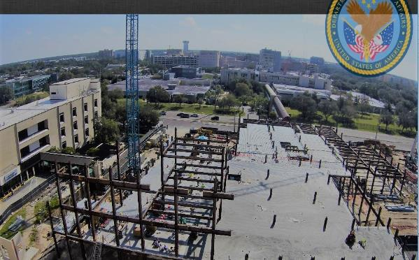
SAME Jacksonville
Post Industry Day
30 Oct 2019
COL Sebastien Joly
District Engineer
USACE-Mobile District
James A. Haley VA Medical Center, Tampa, Florida

Slide 2
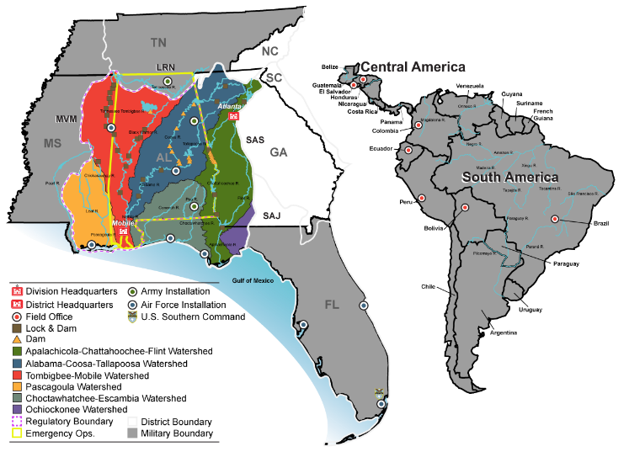

Mobile District
Area of Operations
Colonel
Sebastien Joly
Commander and District Engineer
Mobile District
District Facts:
Established in 1815, the Mobile District employs 1,100 civilian personnel and approximately 10 military officers with a presence that covers the states of Alabama, Florida, Georgia, Mississippi as well as all Central and South America. The Mobile District manages a $1 billion Military, Civil Works, and International/Inter-agency Support program that responds to disasters, manages water resource infrastructure, protects the environment, and provides facilities for our national defense and inter-agency partners.
The Civil Works mission includes the operation and maintenance of six major river systems providing over 2,200 miles of navigation, seven deep-water harbors, 21 shallow draft ports, and flood control with over 67 projects that have prevented in excess of $200 million in flood damages over the last ten years. The District’s eight hydropower facilities generate 2.06 billion kilowatts of electricity and return $44.8 million of the U.S. Treasury. Mobile also manages one of the largest recreation programs in the Federal government with 27 lakes and 464 recreation areas averaging more than 34.1 million visitors a year.
Mobile District provides project management, construction, and engineer services to support the Department of Defense Military Construction, International support to U.S. Southern Command (SOUTHCOM), and Inter-Agency Support to NASA, FBI and other federal agencies. The District also provides engineering studies and other technical assistance such as master planning, environmental management and real estate support.
Notes:
Mobile District Area of Responsibility:
Military Program Footprint extends from Arnold AFB, TN, Columbus AFB, MS, all Army & AF Bases, Alabama and all Air Force Bases in Florida
Civil Boundaries include Gulf Coast from (West) Pearl River, MS to (East) ACF River System and inland waterways within watershed.
Central & South America

Slide 3
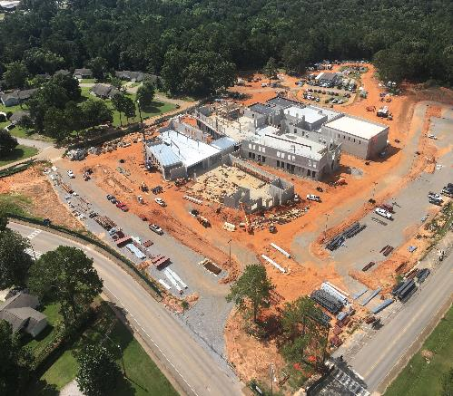
Program Trends & Observations
Priorities: Deliver the Program, Revolutionize Delivery
    - Tyndall AFB Recovery
    - Mobile Harbor
    - Veterans Administration
Huge, diverse program…..and growing
- MILCON (Tyndall, Eglin, Redstone, Patrick /Cape, Hurlburt)
- Medical Support Team role w/MEDCOM DHA
- Environmental – Soil & GW Remediation, Environmental Quality
In midst of acquiring key contract vehicles
- Military AE
- Tyndall AFB D-B
- Construction MATOCs/SATOCs (UR & SB)
- MEDCOM
- REAT successor contracts
Revised AE task order selection procedures
Elementary School, Ft. Rucker, Alabama

Slide 4
A-E Brooks Acts Opportunities – NAICS 541330 Mobile District Area of responsibility (AOR)
Project | Set-Aside Category | Est. Award Value | Projected Advertise Date
AE Services Military Design | UR & SBSA | $249M (shared UR & SB) | W91278-19-R-0034 Posted now, closes 6 Nov 2019
AE Services Environmental Quality for Military, Civil and Federal Agencies (REAT Replacement - Compliance) | $209M UR $40M SBSA | $249M | W91278-19-R-0059 3rd Qtr, FY 20
AE Services Planning & Environmental Division Military & Civil Works (REAT Replacement - NEPA/Master Planning) | $209M UR $40M SBSA | $249M | W91278-18-R-0021 Posted FBO now, closes 13 Nov 2019
Notes:
These solicitations have priority:
AE MILCON – “draft” removed from announcement will close 6 Nov 2019.
W91278-19-R-0021 Military Environmental Planning Solicitation posted now closes 13 Nov 2019.
New AE environmental contracts are for use in Mobile AOR versus previous awards with SAD AOR.
Col Joly Background note – not for audience: AE MILCON will be evaluated first. Planning/Engineering Environmental will be replacement contracts for current REAT.
AF AE DCS-13 contracts – Mobile borrowed $240m capacity to initiate task orders for Tyndall AFB Zones.

Slide 5
A-E Brooks Acts Opportunities – NAICS 541330 Mobile District Area of responsibility (AOR)
Project | Set-Aside Category | Est. Award Value | Projected Advertise Date
Civil Works Design AE | TBD | $49M | Sources sought to advertise 1st Qtr, FY20
MEDCOM AE | TBD | $49M | Sources sought to advertise 1st Qtr, FY20
AE Planning – focus area is Master Planning | Total SBSA | $10M | W91278-19-R-0110 Advertise 2d Qtr FY20
AE Services Environmental Restoration (REAT Replacement – HTRW) | TBD | $99m | Sources Sought to advertise 1st Qtr FY20
Notes:
Sources Sought/Market Research will advertise in 1st quarter FY 20 for AE Civil Design and MEDCOM AE.
.

Slide 6
Construction- NAICS 236220 (unless otherwise noted)
Project | Set-Aside Category | Est. Award Value | Projected Advertise Date
Military Construction North/South Regions Mobile District AOR 2 Phase D-B MATOCs | $245M (2) UR $200M (2) SBSA | $845M capacity | W91278-18-R-0003 SBSA to advertise 1st Qtr FY20 W91278-18-R-0001, 0002 & 0004 3d Qtr FY20
7.5MW Generator, ERCIP, Anniston Army Depot “C“ Type Contract | TBD | <$20M | June 2020
Aircraft & Flight Equip Bldg Redstone Arsenal | TBD | >$30M | December 2019
RCO Hangar & Wing HQ, Patrick AFB, Florida “C“ Type Contract | UR | >$100M | August 2020
JP-8 Fuel Tanks, Patrick AFB, Florida, NOTE: NAICS 237120, Size Standard $39.5m – “C“ Type Contract | TBD | <$10M | Sources Sought posting soon.
Notes:
SB MATOC W91278-18-R-0003 will move forward to solicit, evaluate and award before end of fiscal year 2020. Two Unrestricted MATOC Pools and one SBSA Pool will follow later in FY 20
For projects not marked MATOC will be stand alone “C” type contracts.

Slide 7
Construction Continued (All “C” type Contracts)
Project | Set-Aside Category | Est. Award Value | Projected Advertise Date
Cyberspace Test Group Facility, Eglin AFB, FL | TBD | >$30M | December 2019
ACURL Phase II, Eglin AFB, FL | TBD | >$20M | December 2019
Terminal Engagement Research Facility (TERF), Eglin AFB, FL | SBSA | <$10M | W91278-20-R-0002 Advance Notice Posted
SOF AMU & Weapons Hangar, Hurlburt Field, FL | UR | >$50M | January 2020
Maint Training Facility Hurlburt Field, FL | UR or SB | <$20M | December 2019
Notes:
Stand alone “C” type contracts. All Design-Bid-Build.

Slide 8
Construction Continued
Project | Set-Aside Category | Est. Award Value | Projected Advertise Date
MEDCOM Western Region 2 Phase D-B MATOC | UR and SBSA | $249M | 1st Qtr, FY20 Acquisition cycle beginning soon
Aircraft Maint Hangar Soto Cano, Honduras D-B-B “C” Type contract | UR | >$230M | 2nd Qtr, FY20
South America, Northern Region 2 Phase D-B MATOC | UR | $40M (IDIQ capacity) | 2nd Qtr, FY20
WF George Earthen Dam Repair, Henry County, Alabama, Clay County, Georgia D-B-B, NAICS 237990, “C” Type contract | UR | <$50M | W91278-19-R-0076 Pre-solicitation posted now.
Horizontal Construction MATOC To support Operations Division Projects NAICS -237990 | WOSB | $1.9M (IDIQ capacity) | 1 Qtr FY20 W91278-19-R-0030, awaiting seed project.
Notes:
Sources sought on MEDCOM FY 20.
WOSB – Women-Owned Small Business

Slide 9
TYNDALL AFB Rebuild
$3B MILCON Requirement
42 Projects (1391s) across 12 zones
- Mobile District - zones 1-9
- Savannah District – zones 10-12
Design-Build Approach
- RFPs developed by AE from AF DCS-13 IDC
- First zones RTA in April 2020
USACE Acquisition Planning for D-B execution underway
- Goal: Award FY 19/20 funded zones by 30 Sep 20
- Pre-Quals vs 1-step vs 2-step D-B
- SATOC vs MATOC vs “C” contracts
- Small Business Participation

Slide 10
Tyndall Reconstruction Program
Project | Set-Aside Category | Est. Award Value | Projected Advertise Date
Zone 1 – Flightline F-35 Parts Store Fuel Cell Weapons Load Hangars 1, 2 & 3, NDI Physiology Aircraft Parking Apron OG/MXG Aux Ground Equip Facility Ops/Aircraft Maint Simulator Facility Unit/Hangars #2&3 Washrack Weapons Load Trng MXS Hangar | TBD | <$500M – All 1391s | FY20
Zone 2 - Flightline Operations OSS/Radar Approach Control Fac, A/craft MS Fuel Cell Hangar Aerospace & Oper Physiology Fac, Spec Purpose Veh Maint Aircraft Wash Rack Ops Group/Maint Group HQ Deployment Ctr/Flightliine Dining/AAFES | TBD | <$200M | FY20
Notes:
Set aside category TBD still reviewing market research
Zone 1 has eleven 1391’s maybe one solicitation.
Zone 2 -Likely Vehicle Maintenance Facility will be Small Business Set-Aside (SBSA)

Slide 11
Tyndall Reconstruction Program
Project | Set-Aside Category | Est. Award Value | Projected Advertise Date
Zone 3 – WEG 53 WEG Hangar HQ Facility Subscale Drone Facility Mu-2 Hangar, Parking Apron | TBD | <$500M | FY 20
Zone 4 Infrastructure Phases 1 & 2, Site Development Utilities & Demo Phase 1 & 2 Tyndall AFB Gate Complexes | TBD | <$500M | FY20
Zone 5 – Industrial CE/Contracting/USACE Complex Logistics Readiness Squadron Complex | TBD | <$500M | FY20
Notes:
Zone 3 -Two UR solicitations
Zone 4 – Two UR solicitations
Zone 5 – Three solicitations with one SBSA for CE HQ

Slide 12
Tyndall Reconstruction Program
Project | Set-Aside Category | Est. Award Value | Projected Advertise Date
Zone 6 - Airfield Drainage Develop comprehensive storm drainage system | TBD | <$500M | FY20
Zone 7 – MSA Facilities 7000 area – two magazine storage facilities & missile assembly | TBD | <$100M | FY20
Zone 8 - Administration 325th Fighter WG HQ Fac Emergency Mgmt/Ops Ctr Alt CP, Sec Forces Mobility Storage Fac Small Arms Range | TBD | <$100M | Advertise FY20 – Award1st Qtr FY 21
Zone 9 – MWR Facilities | SBSA | <$100M | Advertise FY21
Notes:
Zone 6 maybe UR
Zone 7 projected to be Small Business Set-aside
Zone 8 325 HQ UR, rest of projects SB

Slide 13





Mobile District Contacts
Internet and Social Media
Phone & Mailing Address
Public Affairs Office (General Information)
(251) 690-2505
U.S. Army Corps of Engineers
Mobile District
P.O. Box 2288
Mobile, AL 36628-0001
Small Business Contacts:
Linda.L.Spadaro or Cy.C.Simons@usace.army.mil
251-690-3597 & 3579
sam.usace.army.mil
facebook.com/usacemobile
twitter.com/usacemobile
Instagram.com/usacemobile
flickr.com/photos/usacemobile
Notes:
Contact Information

