Slide 1
Jacksonville district prograM briefiNG
Presented to: SAME Jacksonville Industry Day
Presented by:
Tim Murphy, P.E., PMP
Deputy District Engineer for Programs and Project Management
Jacksonville District
December 4, 2018

Slide 2
Briefing purpose/Agenda
Provide a brief overview of the Jacksonville District Area of Responsibility
Jacksonville District Program Areas
Upcoming Contracting Opportunities
Questions and Answers

Slide 3

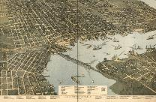
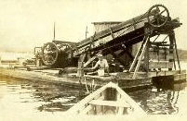
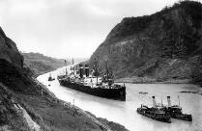
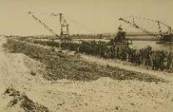
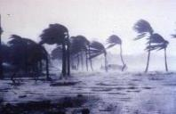
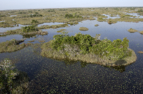
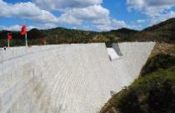
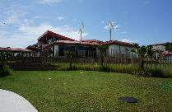
JACKSONVILLE DISTRICT: PROUD HISTORY
1884
First permanent USACE office in Jacksonville
(Captain W.T. Rossell)
1928
Tampa Harbor
dredged
1950
Jacksonville assumes responsibilities of Panama District including Puerto Rico & U.S. Virgin Islands
1960
Herbert Hoover Dike
improvements
completed
1992
Hurricane Andrew strikes,
Jacksonville leads USACE
response
2000
Congress authorizes
Comprehensive Everglades Restoration Plan (CERP)
2014
Portugues Dam
completed
2016
Antilles School
Fort Buchanan
(LEED Certified)
Notes:
Background image: Jax Harbor late 1880s. The reason our district is located in Jacksonville is because of the shoaling issues in the St. Johns River.
The Corps of Engineers dates back to the very beginnings of our great nation
A permanent presence in Florida was established by the Corps in the late 1800s
The Corps’ initial involvement in Florida included improvement to ports and regulation of obstacles to navigation
Jacksonville District absorbed the Panama District in 1950, which resulted in Puerto Rico and the US Virgin Islands being added to our area of responsibility
Jacksonville District has been leading the largest ecosystem restoration program in the world with work on the Kissimmee River and the Florida Everglades
One of our most recent major accomplishments was the completion of Portugues Dam in Puerto Rico in early 2014

Slide 4
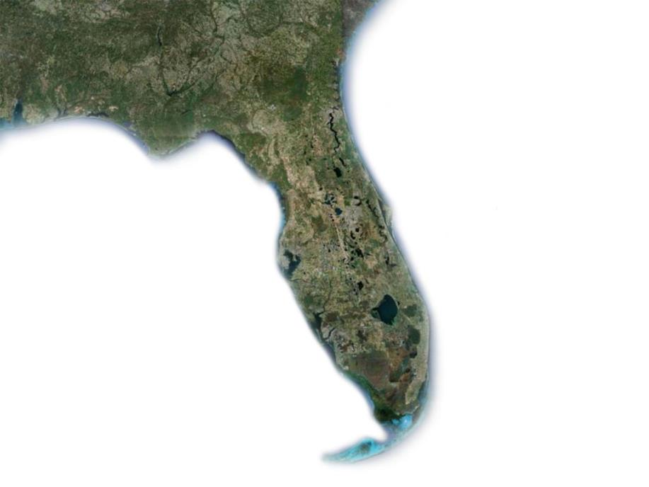


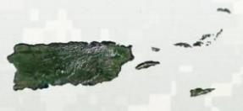
JACKSONVILLE DISTRICT OFFICES
AND AREAS OF RESPONSIBILITY
GEORGIA
FLORIDA
DISTRICT
HEADQUARTERS
Jacksonville
Pensacola
Panama City
Gainesville
Palatka
AREAS OF RESPONSIBILITY
FIELD OFFICES
CIVIL WORKS
Portions of Florida and Georgia
(defined by watersheds)
Puerto Rico and the Antilles
REGULATORY
Florida
Puerto Rico and the Antilles
REAL ESTATE AND MOBILIZATION
Portions of Florida and Georgia
Puerto Rico and the Antilles
Cocoa
Tampa
Melbourne
Sebring
West Palm Beach
Palm Beach Gardens
Clewiston
Wellington
Ft. Myers
Naples
Miami
Mobile
District
San Juan
Jacksonville
District
CIVIL WORKS AREA
OF RESPONSIBILITY (FLORIDA AREA)
U.S Virgin Islands
As of: 7 May 18/POC: Mike Rogalski CESAJ-PM
Notes:
Civil Works in Florida: boundary breaks along the Suwannee River.
Real Estate in Florida: boundary breaks at the Apalachicola River.
Regulatory Boundary: Entire State of Florida plus Puerto Rico
Military Customers: Mobile District

Slide 5
MAJOR CUSTOMERS, STAKEHOLDERS
AND PARTNER AGENCIES
South Florida Water Management District (SFWMD)
Port Authorities (Jacksonville, Miami, Everglades, Tampa and Canaveral)
Coastal communities (Counties, Cities and Municipalities)
Florida Department of Environmental Projection (FDEP)
Fort Buchanan (PR)
Command Navy Region SE, USAID
Puerto Rico Department of Natural Environmental Resources (DNER)
Department of Interior (including USFWS, US Forest Service and Everglades and Biscayne National Parks)

Slide 6
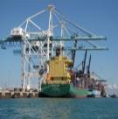
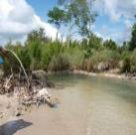
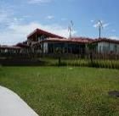
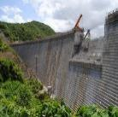
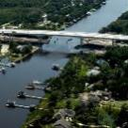
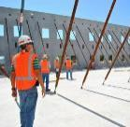
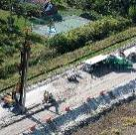
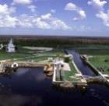
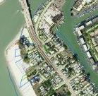
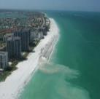
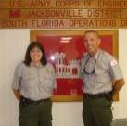
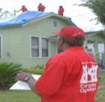
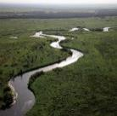
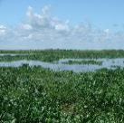
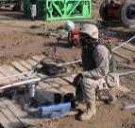
OUR MISSION AREAS
Deliver value to the Nation by anticipating needs & collaboratively engineering solutions
that support national security, energize our economy, & increase resiliency.
NAVIGATION
REGULATORY
MILITARY SUPPORT
Navigation
Flood/Coastal Storm
Risk Management
Ecosystem Restoration
Operations/Recreation
Contingency Operations
Real Estate
Military/Interagency
& International Services
Regulatory
INTERAGENCY & INTERNATIONAL
SERVICES
FLOOD RISK
MANAGEMENT
REGULATORY
HERBERT HOOVER DIKE
OPERATIONS
LOCKS & DAMS
REAL ESTATE
COASTAL STORM
RISK MANAGEMENT
OPERATIONS
RECREATION
CONTINGENCY
OPERATIONS:
EMERGENCY MGM’T
ECOSYSTEM
RESTORATION
OPERATIONS
AQUATIC PLANT
CONTROL
CONTINGENCY
OPERATIONS: MILITARY
As of: 29 Jan 18/POC: Mike Rogalski CESAJ-PM
Notes:
Overarching messages
We are a science- and data-driven organization, made up of a wide range of highly trained professionals—engineers, biologists, economists, etc.
We work within the authorities given us by the Congress.
We conduct extensive studies, surveys and analyses of the effects, benefits and engineering requirements associated with our projects.
Corps and independent panels subject our studies and analyses to rigorous independent technical and economic reviews.
Only projects that pass these reviews move forward to Congress for authorization and funding.
Most of our projects require financial support from a local, non-federal sponsor.
We are entirely transparent about our data. All of our reports, along with comments from reviewers and the public and the associated responses, are freely available on our website.
We are an environmentally sensitive organization and go to great lengths to minimize and mitigate effects of projects on the environment.
Jacksonville District is a national leader in ecosystem restoration (Everglades) and protection of wetlands.
The District is growing—we need to hire nearly 100 additional professionals in a wide range of technical and scientific specialities over the next year.

Slide 7
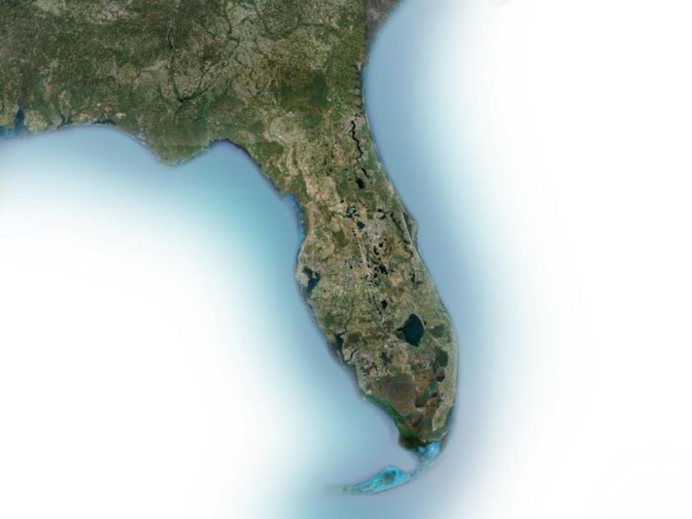

OUR MISSION
COASTAL STORM RISK MANAGEMENT
GEORGIA
Nassau County
FLORIDA
Duval County
St. Johns County
Flagler County
Brevard County
Pinellas County
Manatee County
St. Lucie County
Sarasota County
Martin County
COUNTIES WITH PARTICIPATION IN
CSRM PROJECTS
Palm Beach County
Lee County
Broward County
Dade County
Monroe County

Slide 8
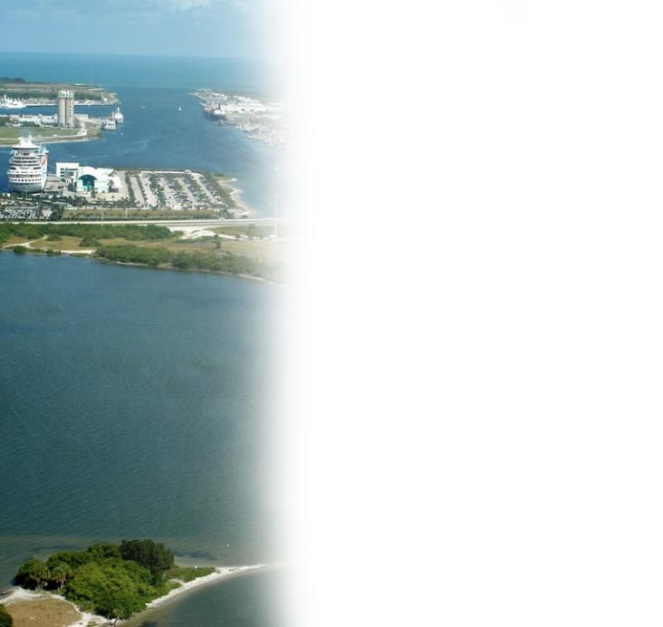
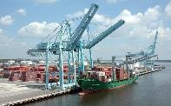
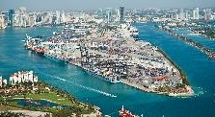
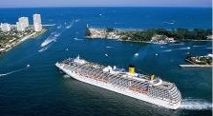
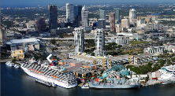
OUR MISSION
NAVIGATION
900 miles of Inland Waterways
6 navigation locks
Intracoastal Waterway (IWW) from
Jacksonville to Miami
Okeechobee Waterway (OWW) connecting the
Atlantic Ocean to the Gulf of Mexico
Parts of the Gulf Intracoastal Waterway (GIWW)
Harbors
17 Deep Draft Harbors
20 Shallow Draft Harbors
JACKSONVILLE HARBOR
MIAMI HARBOR
PORT EVERGLADES
TAMPA HARBOR
8
Notes:
Navigation:
Jacksonville District is responsible for 17 deep draft harbors and 20 shallow draft harbors in Florida and the Caribbean, as well as roughly 900 miles of navigable inland waterways.
•
The goal of the navigation program is to provide a safe, reliable, and efficient waterborne transportation system (channels, harbors, and waterways) for the movement of commerce, national security needs, and recreation, and to provide a safe harbor from severe storms.
•
Our Water Resources Branch manages roughly $55 million dollars annually, operating and maintaining Federal navigation harbors to promote safe and efficient navigation.
•
Southeast U.S. ports are the least prepared to meet the increasing demands of a global economy and larger ships. Navigation improvements can accommodate existing and future vessel movement, and energize the economy.
•
The District completed the Miami Harbor deepening project in 2015, making it the first federal harbor in the southeast built to a 50-foot depth. Miami is the first project of its kind in the nation where the local sponsor provided all funding in advance to expedite project execution.
•
The Jacksonville Harbor deepening is a nationally significant infrastructure project because it hosts military installations that support the nation’s defense. JaxPort is currently seeking non-federal funding. For every $1 spent on this project, we anticipate $2.70 returned to the nation. (Estimated project cost is $684M.)
•
The Port Everglades’ improvement project awaits congressional authorization. For every $1 spent on this project, we anticipate a return of $2.90 for the nation. (Estimated project cost is $381M.)

Slide 9
**PL115-123 Supplemental disaster response UPDATE
--INVESTIGATIONS: 8 projects, $27,233,000 approved, $4,642,000 funds issued, $4,642,000 budget authority, $454,000 obligations, $378,500 expenditures.
--CONSTRUCTION (Long Term): 21 projects, $3,308,613,000 approved, $20,107,000 funds issued, $20,107,000 budget authority, $1,460,000 obligations, $1,084,000 expenditures.
CONSTRUCTION (Short Term): 1 project, $50,000 approved, $50,000 funds issued, $50,000 budget authority, $8,357 obligations/$8,357 expenditures.
--FCCE: 10 projects, $184,564,000 approved, $72,283,000 funds issued, $72,283,000 budget authority, $15,517,000 obligations, $596,400 expenditures.
--O&M: 17 projects, $83,290,000 approved, $47,948,000 funds issued, $47,948,000 budget authority, $11,306,000 obligations, $1,718,000 expenditures.
--TOTAL: 62 projects, $3,615,143,000 approved, $146,629,000 funds issued, $146,629,000 budget authority, $28,807,000 obligations, $3,847,000 expended.
**As of 19 Nov 18

Slide 10
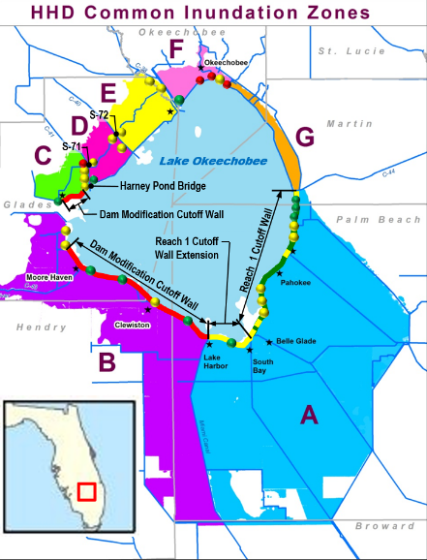

Herbert hoover dike implementation plan
Completed Work
21.4 miles of cutoff wall in Reach 1 (38% of total cutoff wall construction)
9 culvert replacements and 1 removal (32% of total culverts being addressed)
Ongoing Work
18 culvert replacements (56% of total culverts)
Reach 1 Cutoff Wall Gap Closures
6.6 mile Reach 1 Cutoff Wall Extension (12% of total cutoff wall construction)
Planned Work
28.6 miles of cutoff wall construction (50% of total cutoff wall construction)
1 culvert replacements (3% of total culverts)
3 culvert abandonments (9% of total culverts)
Harney Pond Bridge Armoring
S-71 and S-72 Embankment Raising

Slide 11
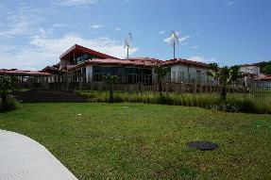
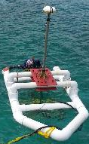
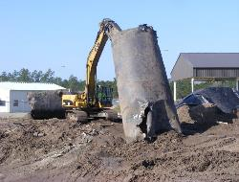
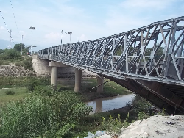
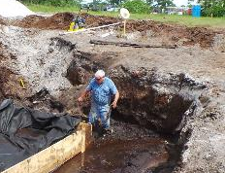
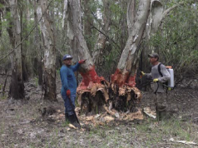
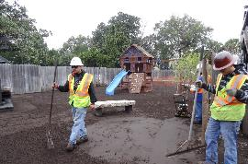
OUR MISSION
MILITARY/INTERAGENCY & INTERNATIONAL SERVICES
MILITARY SUPPORT
INTERNATIONAL SUPPORT
LEED Certified
Antilles Elementary School
(Fort Buchanan, Puerto Rico)
Formerly Used Defense Sites (FUDS)
Underwater Assessment (Culebra, Puerto Rico)
& Fuel Tank Removal (Arecibo, Puerto Rico)
Assessment of Failed Bridge(Haiti)
INTERAGENCY SUPPORT
Mosquito Slough
Invasive Species
Management
National Resources Conservation Service
Florida Easement Program -
Ecosystem Restoration
Environmental Protection Agency
JaxAsh - Superfund Cleanup Oversight
11
Notes:
MIL/IIS program
SAJ manages the Formerly Used Defense Sites (FUDS) program in Florida, Puerto Rico and the U.S. Virgin Islands.
•
The district's FUDS program includes work at 146 sites (out of an original total of 287).
•
In FY16, we received $17.3 million in funding for 68 sites.
•
The sites range in size from the 60,000 acre former US Air Force Avon Park Range in Florida, to the 9,000 acre site in Culebra, Puerto Rico, and underground petroleum tank sites that are less than an acre.
•
This branch is unique in its ability to acquire work and currently supports 19 different agencies at home and abroad.
•
The program consists of four distinct components: reimbursable civil and military projects, environmental compliance, and international infrastructure and water resources related projects.
•
In 2015, the branch doubled their revenue, executing $60 million in work.
•
The branch represents 10 percent of the district workforce but executed 40 percent of district contract actions in 2015.
•
Our Formerly Used Defense Site (FUDS) program is the 4th largest in the Corps -executing $12 million in 2015.

Slide 12
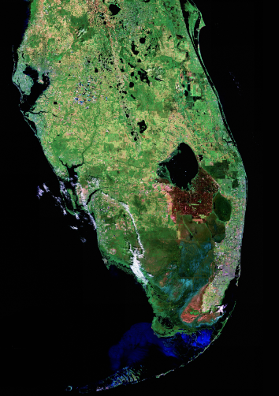
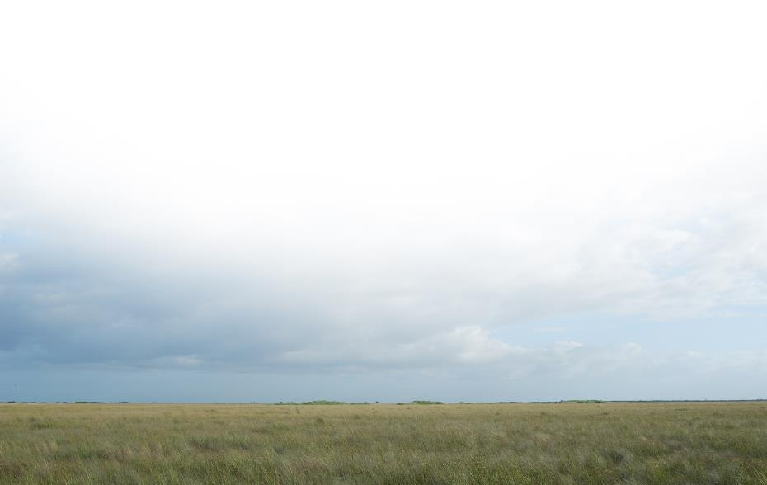
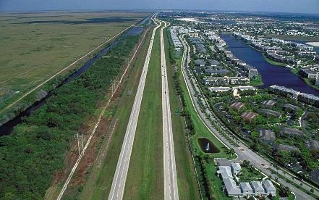
OUR MISSION
ECOSYSTEM RESTORATION: EVERGLADES RESTORATION
Planning in an area twice the size
of New Jersey (18,000 square miles)
Intense stakeholder interest
Strong federal and state partnership
throughout program
Everglades
National
Park
New
Jersey
12
Notes:
Ecosystem Restoration
Through Congressional appropriations, the Corps has invested $2.4 billion to date into ecosystem restoration in south Florida under the South Florida Ecosystem Restoration program, which includes CERP.
•
Significant progress has been made to restore America's Everglades, which will ultimately improve 2.4 million acres of south Florida’s ecosystem (including Everglades National Park), reduce high-volume discharges from Lake Okeechobee to the estuaries, improve water deliveries to Florida and Biscayne bays, and enhance water supply.
•
The Federal-State partnership continues to be the strength of CERP, an unparalleled ecosystem restoration effort. The Corps and State of Florida have each invested over a billion dollars to date ($1.027B and $1.067B, respectively) in this critically important ecosystem restoration effort.
•
In FY 2017, the district will receive $106 million for ecosystem restoration—almost a third (32% ) of the total of $336 million that the Corps will receive for nationally for this purpose

Slide 13
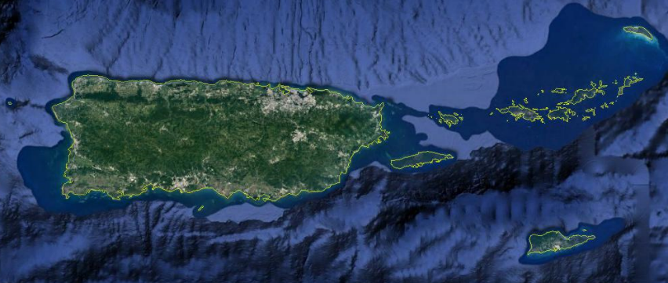
FLOOD RISK MANAGEMENT & Ecosystem restoration: Antilles
RIO GRANDE
DE ARECIBO (C)
RIO DE LA PLATA (C)
RIO PUERTO
NUEVO (C)
SAN JUAN METRO COASTAL (I)
RIO
CULEBRINAS (I)
AGUADILLA
SAVANT GUT
PHASE II (I)
ARECIBO
SAN JUAN
CAÑO MARTIN PEÑA (I)
RINCON
RIO GRANDE
DE MANATI (I)
MAYAGUEZ
Puerto Rico
RIO GRANDE DE LOIZA (C)
CHARLOTTE
AMALIE
TURPENTINE
RUN (I)
RIO GUANAJIBO (C)
CAGUAS
RIO GUAYANILLA (I)
RIO NIGUA (C)
USVI
PONCE
GUAYANILLA
SALINAS
PORTUGUES & BUCANA (C)
ESTATE LAGRANGE
CAP 205 (C)
CHRISTIANSTED
PUERTO RICO COASTAL (I)
FREDERIKSTED
LEGEND
ACTIVE PROJECT
C: CONSTRUCTION I: INVESTIGATIONS

Slide 14
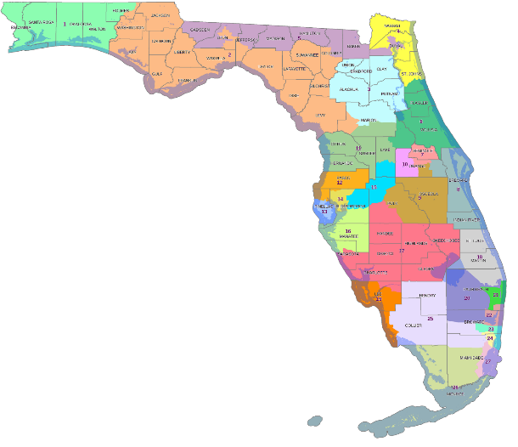
Jacksonville District
Active CAP Projects
BIG FISHWEIR CREEK (206)
FORT GEORGE INLET
(111)
(NS)
ALLIGATOR CREEK
(205)
(NS)
AIBONITO (205)
(NS)
LOIZA (14)
ST.FRANCIS BARRACKS (14)
(NS)
PORPOISE POINT (103)
(NS)
PUERTO RICO
USVI
SAN
GERMAN
(14)
YABUCOA (205) (NS)
RIO ANTON RUIZ RESTORATION (1135)
MERCEDITA
(205)
(NS)
LAKE TOHO (1135)
(NS)
LAKE WORTH LAGOON (1135)
CAP Authority Legend
Section 14 – Emergency Streambank Protection
Section 103 – Hurricane & Storm Damage Prevention
Section 111- Shoreline Damage Attributable to Federal
Navigation Project
Section 205 – Flood Damage Reduction
Section 206 – Aquatic Ecosystem Restoration
Section 1135 – Environmental Restoration Due to the Impacts of a Federal Project NS
(NS) – Awaiting New Start
PAHOKEE RESTORATION (1135)
MT.SINAI (14)
BILLY’S CREEK
(206)
(NS)
ISLAMORADA
(103)
(NS)

Slide 15

EXECUTION OF WORK
The Work Delivered by:
Construction
Contractors
Unlimited Capability
…Perform 100% of
Civil Works/Military
Construction
Architect-Engineer Firms
Perform 80% of Military, 40% CW
Planning & Design
~33,000
Federal
Employees
JAX
~880
Sponsors, Federal Agencies, Associations
BUILDING STRONG®
15

Slide 16
DISTRICT EXECUTION
Civil Works including flood and coastal risk management/navigation and ecosystem account for
86 % of the Districts Program
FY18 Program: Heavy reliance on Best Value (Request for Proposal - RFP)
and lowest price (Invitation for Bid - IFB)
  AE IDIQs and Other Professional Svc contracts
  Construction MATOC (dredging and Herbert Hoover Dike)
  8(a) SATOCs
  Extensive regional sharing of contract capacity (w/in SAD) (Regional Environmental Acquisition Tool - REAT)

Slide 17
Jacksonville District Funding
FY 2017 – FY 2019 ($1,000’s)
 | I | C | O&M | Total
FY 2017 President’s Budget | 1,755 | 155,500 | 51,458 | 208,713
FY 2017 Allocation | 5,584 | 241,367 | 85,308 | 332,259
FY 2018 President’s Budget | 400 | 158,500 | 62,374 | 221,274
FY 2018 Allocation | 2,419 | 270,976 | 94,574 | 367,969
FY 2019 President’s Budget | 0 | 163,500 | 57,250.5 | 220,750.5
Legend:
Increase/Decrease from previous year President’s Budget
Increase in allocation from previous year allocation
Notes:
SLIDE 17 - DISTRICT FUNDING HISTORY: FY 2017 – FY 2019 (Jerry Grubb)
Notes:
FY 2017 President’s Budget for SAJ in the amount of $208,713 is down from the FY 2016 President’s Budget amount of $251,960 (I: $1,400 + C: $189,583 + O&M: $60,977 = $251,960).
FY 2017 allocation data was based on the FY17 EOY 3011a and does not include Supplemental funding.
FY 2018 allocation is the same as the FY 2018 President’s Budget since the expected FY 2018 Work Plan is still under development as of 01/20/2018.
FY 2019 President’s Budget was published on Monday, 02/12/2018.
Last updated on: 02/13/2018
Last update by: Jerry Grubb

Slide 18
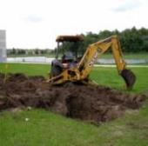

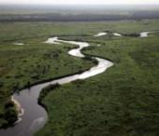
JACKSONVILLE DISTRICT PROGRAMS by Fiscal Year (FY)
$ Millions
Summary does not include SAJ Regulatory Program
* FY19 PBUD; all other Fiscal Years reflect actual allocations, $ amounts are in millions
Notes:
Notes: pictures clockwise from the top: FUDS site excavated, Miami-Dade beach, Kissimmee River Ecosystem
District Trends (also included on a separate District trends slide)
Herbert Hoover Dike Rehabilitation: increased $82-million to $96-million *
South Florida Ecosystem Restoration (SFER) construction: decreased: $77-million to $68-million
Flood Control Coastal Emergency: no change $0 to $0
Water Resources Program Construction: no change $0 to $0
Water Resources Program Operations and Maintenance: decreased $62-million to $57-million
Regulatory Program: no change $17.2-million to $17.2-million
FUDS Program: decreased $7.3-million to $5.1-million
MILCON (Total): decreased $39-million to $24-million

Slide 19
JACKSONVILLE DISTRICT
WORKLOAD TRENDS
Fiscal Year (FY) 2018 to FY 2019 Trends
  Herbert Hoover Dike Rehabilitation: increased $82-million to $96-million *
  South Florida Ecosystem Restoration (SFER) construction: decreased: $77-million to $68-million
  Flood Control Coastal Emergency: no change $0 to $0
  Water Resources Program Construction: no change $0 to $0
  Water Resources Program Operations and Maintenance: decreased $62-million to $57-million
  Regulatory Program: no change $17.2-million to $17.2-million
  FUDS Program: decreased $7.3-million to $5.1-million
  MILCON (Total): decreased $39-million to $24-million
* The Dam Safety and Seepage/Stability Correction Program includes an additional $66.405 million to accelerate the rehabilitation of the Herbert Hoover Dike in FY 2019 provided the State of Florida has contributed $100 million or more by September 30, 2019, of its total commitment to provide $200 million for such work.
Notes:
Jacksonville District trends broken out from previous slide with color scheme (Green increase or steady), red, decrease

Slide 20
DOING BUSINESS WITH THE CORPS OF ENGINEERS
Know the mission and area of responsibility of USACE District.
Websites/social media– get smart on FBO, FPDS-NG, District websites, USASpending.gov
Take advantage of industry days, site visits and pre-proposals (free marketing).
Relationships – focus on relationships with the right people.
Familiarize yourself with DoD contracting regulations and procedures.
Consider Subcontracting opportunities.
Follow the money.
READ! READ! READ!
Notes:
For instance the Jacksonville District has a very unique mission. We are primarily a civil works district. Our AOR covers the State of Florida, Puerto Rico, and the US Virgin for civil works. However, Mobile District has the military mission for Florida. Before you market or focus on a specific Distrct, make it a point to earn about the District by researching there website. Use various websites to learn what the District has procured previously. You cannot market your firm as a solution provider if you don’t know the mission and work the district does.
Websites and social media are becoming more & more critical if you want to stay on top of what and when we are buying. For instance when we update our acquisition forecast, notices are also posted on facebook and twitter. If you need help with these websites, contact our SB office.
You can learn so much about our program and what is coming up by attending industry days, site visits, etc. Not to mention it is free marketing and could potentially open up opportunities for teaming & subcontracting.
Yes relationships are important but you need to focus on relationships with the right people. For instance at our District start with our small business office. That should always be your first contact to the District. Yes our SB office also assists LB firms as well. Focus on establishing relationships with other individuals and firms in industry. This will open up the door to more opportunities as well as counsel and possibly mentor you as seek to grow your business.
You will not be successful in government contracting if you don’t take the time to familiarize yourself with contracting regs and procedures. For instance the difference between and IFB and RFP. SAJ uses both of these procurement methods. You will not be able to submit qualifying proposals if you don’t know what the proposal requirements are. The government cannot make you whole for a bad business decision based on lack of knowledge.
6. Especially if you are a new or small business. Focus on building a portfolio of past performance. Regardless of your product or service, it is important to consider our very large secondary market. We encourage you to consider contractor teaming arrangements.
7. Now what do I mean when I say follow the money. In government spending it is always wise to know what spending is in the President’s budget. Where is focus of the govt spending for the upcoming year. Is it in military spending, infrastructure, maintenance, etc. Knowing that will help you know where to focus your marketing efforts, teaming, etc. This is public information.
8. Seems very simple but so many fall short in this area. Most of the proposals that don’t make it to award is because they didn’t read the requirements. Not because they aren’t capable. But they missed something. It is always a good idea to have someone conduct an independent review of your proposal before it is submitted.

Slide 21
Jacksonville District FY2019 & Beyond Contracting Opportunities
Fiscal Year | Project Title | Project Location | Projected Advertise Date | Type Work | Estimated Award | Set-Aside Category | Procurement Method
2020 | Jax Harbor Deepening Contract C | Duval County,FL | May 2020 | DREDGING 237990 | $180,000,000 -$225,000,000 | UNR | RFP
2021 | Jax Harbor Deepening Contract D | Duval County,FL | May 2021 | DREDGING 237990 | $100,000,000 - $150,000,000 | UNR | RFP
2019 | O&M Dredging Kings Bay Entrance | Nassau County, FL | July 2019 | DREDGING 237990 | $15,000,000 - $25,000,000 | UNR | IFB
2020 | O&M Dredging Kings Bay Inner Channel | Camden County, FL | Nov 2019 | DREDGING 237990 | $10,000,000 - $15,000,000 | SB | IFB
2019 | O&M Dredging USMC Support Facility Blount Island | Duval County, FL | Feb 2019 | DREDGING 237990 | $1,000,000 - $5,000,000 | SB | IFB
2019 | O&M Dredging Canaveral Harbor | Brevard County, FL | Dec 2018 | DREDGING 237990 | $5,000,000 - $10,000,000 | UNR | IFB
View all of Jacksonville District Contracting Opportunities at:
www.saj.usace.army.mil/Business-With-Us/Small-Business/
Notes:
NOTE: the first four pages of opportunities are made up of navigation and shore protection projects

Slide 22
Jacksonville District FY2019 & Beyond Contracting Opportunities
Fiscal Year | Project Title | Project Location | Projected Advertise Date | Type Work | Estimated Award | Set-Aside Category | Procurement Method
2019 | Brevard County, Mid & South Reaches CSRM (FCCE SUPP) Hopper & Truck Haul | Brevard County, FL | May 2019 | DREDGING 237990 | $25,000,000 - $50,000,000 | UNR | RFP
2019 | St Lucie South Segment CSRM (SUPP) | St. Lucie County, FL | May 2019 | DREDGING 237990 | $10,000,000 – $25,000,00 | UNR | IFB
2019 | O&M Dredging Palm Beach Harbor | Palm Beach County, FL | Nov 2018 | DREDGING 237990 | $1,000,000 – $5,000,000 | UNR | IFB
2020 | Palm Beach County CSRM (FCCE SUPP) Delray Beach | Palm Beach County, FL | Oct 2019 | DREDGING 237990 | $5,000,000 – $10,000,00 | UNR | IFB
2020 | Palm Beach County CSRM (FCCE SUPP) Jupiter Carlin | Palm Beach County, FL | Oct 2019 | DREDGING 237990 | $10,000,000 – $25,000,00 | UNR | IFB
2020 | Palm Beach County CSRM (FCCE SUPP) Boca Raton | Palm Beach County, FL | Jul 2020 | DREDGING 237990 | $10,000,000 - $25,000,000 | UNR | IFB
View all of Jacksonville District Contracting Opportunities at:
www.saj.usace.army.mil/Business-With-Us/Small-Business/

Slide 23
Jacksonville District FY2019 & Beyond Contracting Opportunities
Fiscal Year | Project Title | Project Location | Projected Advertise Date | Type Work | Estimated Award | Set-Aside Category | Procurement Method
2020 | Palm Beach County CSRM (FCCE SUPP) Ocean Ridge | Palm Beach County, FL | Jul 2020 | DREDGING 237990 | $5,000,000 - $10,000,000 | UNR | IFB
2020 | Flagler County CSRM (SUPP) | Flagler County, FL | Feb 2019 | DREDGING 237990 | $10,000,000 - $25,000,000 | UNR | IFB
2019 | St Johns County CSRM (SUPP) Vilano Segment | St. Johns County, FL | Jan 2020 | DREDGING 237990 | $25,000,000- $50,000,000 | UNR | IFB
2020 | Port Everglades Nav. Improvements Deepening & Widening | Broward County, FL | Dec 2019 | DREDGING 237990 | $300,000,000 - $400,000,000 | UNR | RFP
2019 | O&M Dredging Port Everglades Harbor | Broward County, FL | Jul 2019 | DREDGING 237990 | $5,000,000 - $10,000,000 | UNR | IFB
View all of Jacksonville District Contracting Opportunities at:
www.saj.usace.army.mil/Business-With-Us/Small-Business/

Slide 24
Jacksonville District FY2019 & Beyond Contracting Opportunities
Fiscal Year | Project Title | Project Location | Projected Advertise Date | Type Work | Estimated Award | Set-Aside Category | Procurement Method
2019 | O&M Dredging St Augustine/Matanzas | St Johns County, FL | Jan 2019 | DREDGING 237990 | $1,000,000 - $5,000,00 | SB | IFB
2019 | O&M Dredging IWW Jupiter/Crosswards/OWW R3 | Martin County, FL | May 2019 | DREDGING 237990 | $1,000,000 - $5,000,00 | SB | IFB
2019 | O&M Dredging Anclote River | Pinellas/Pasco Counties, FL | Jan 2019 | DREDGING 237990 | $1,000,000 - $5,000,00 | SB | IFB
2019 | O&M Dredging Gulf Intracoastal Waterway (GIWW) (SUPP) | Venice Inlet & GIWW Sarasota County, FL | Nov 2018 | DREDGING 237990 | $1,000,000 - $5,000,00 | SB | IFB
2019 | O&M Dredging Ft Myers Inlet | Lee County, FL | Jan 2019 | DREDGING 237990 | $1,000,000 - $5,000,00 | SB | IFB
2019 | Lee County CSRM (SUPP) | Gasparilla Island, FL | Nov 2018 | DREDGING 237990 | $5,000,000 - $10,000,00 | UNR | IFB
View all of Jacksonville District Contracting Opportunities at:
www.saj.usace.army.mil/Business-With-Us/Small-Business/

Slide 25
Jacksonville District FY2019 & Beyond Contracting Opportunities
Fiscal Year | Project Title | Project Location | Projected Advertise Date | Type Work | Estimated Award | Set-Aside Category | Procurement Method
2020 | O&M Dredging Miami Harbor | Dade County, FL | Aug 2019 | DREDGING 237990 | $5,000,000 - $10,000,000 | UNR | IFB
2019 | Palm Beach Harbor Jetty Repairs (SUPP) | Palm Beach County, FL | May 2019 | CIVIL CONST 237990 | $1,000,000 – $5,000,000 | TBD Based on Market Research | IFB
2019 | USMC Blount Island Concrete Sill Removal | Duval County, FL | Apr 2019 | CIVIL CONST 237990 | $10,000,000 - $25,000,00 | TBD Based on Market Research | RFP
2019 | IWW/OWW Construction of DMMA 023 | Martin County, FL | May 2019 | CIVIL CONST 237990 | $5,000,000 - $10,000,000 | TBD Based on market research | RFP
2020 | Big Fishwear Creek Aquatic Eco System Restoration Project | Duval County, FL | Mar 2020 | CIVIL CONST 237990 | $1,000,000 – $5,000,000 | TBD | RFI W912EP19Z0901
2019 | O&M Dredging IWW Broward Reach 1 (SUPP) | Broward County, FL | Jan 2019 | DREDGING 237990 | $1,000,000 – $5,000,000 | SB | IFB
View all of Jacksonville District Contracting Opportunities at:
www.saj.usace.army.mil/Business-With-Us/Small-Business/

Slide 26
Jacksonville District FY2019 & Beyond Contracting Opportunities
Fiscal Year | Project Title | Project Location | Projected Advertise Date | Type Work | Estimated Award | Set-Aside Category | Procurement Method
2019 | Manatee County CSRM (SUPP) | Anna Maria Island, FL | Jan 2019 | DREDGING 237990 | $10,000,000 - $25,000,000 | UNR | IFB
2019 | O&M Dredging Manatee Harbor | Manatee County, FL | Jul 2019 | DREDGING 237990 | $1,000,000 - $5,000,000 | SB | IFB
2019 | O&M Dredging Naples to Gordon Pass (Big Marco) | Naples, Collier County, FL | Jan 2019 | DREDGING 237990 | $1,000,000 - $5,000,000 | SB | IFB
2019 | Manatee Harbor DMMA Offloading | Manatee County | Feb 2019 | CIVIL CONST | $1,000,000 - $5,000,000 | SB | IFB
2019 | Lido Key Beach CSRM (SUPP) | Lido Key, Sarasota County, FL | May 2019 | DREDGING 237990 | $10,000,000 - $25,000,000 | UNR | IFB
2019 | O&M Dredging Suwannee River (SUPP) | Dixie County, FL | Jul 2019 | DREDGING 237990 | $1,000,000 - $5,000,000 | SB | IFB
View all of Jacksonville District Contracting Opportunities at:
www.saj.usace.army.mil/Business-With-Us/Small-Business/

Slide 27
Jacksonville District FY2019 & Beyond Contracting Opportunities
Fiscal Year | Project Title | Project Location | Projected Advertise Date | Type Work | Estimated Award | Set-Aside Category | Procurement Method
2019 | O&M Dredging Arecibo Harbor | Arecibo, PR | Jul 2019 | DREDGING 237990 | $5,000,000- $10,000,000 | UNR | IFB
2019 | O&M Dredging Mayaguez Harbor (SUPP) | Mayaguez, PR | Jul 2019 | DREDGING 237990 | $5,000,000- $10,000,000 | UNR | IFB
2019 | O&M Maintenance Dredging MATOC | South Atlantic Division | Aug 2018 | DREDGING 237990 | NTE $450,000,000 | UNR | RFP W912EP18R0029 Under Eval
2019 | O&M Maintenance Dredging MATOC | South Atlantic Division | Aug 2018 | DREDGING 237990 | NTE $45,000,000 | SB | RFP W912EP18R0029 Under Eval
View all of Jacksonville District Contracting Opportunities at:
www.saj.usace.army.mil/Business-With-Us/Small-Business/

Slide 28
Jacksonville District FY2019 & Beyond Contracting Opportunities
Fiscal Year | Project Title | Project Location | Projected Advertise Date | Type Work | Estimated Award | Set-Aside Category | Procurement Method
2019 | Water Control Structure Culvert Replacement HHD (HP-5) | Palm Beach, Glades, Hendry Counties, FL | Nov 2018 | CIVIL CONST 237990 | $10,000,000 - $25,000,000 | UNR | RFP
2019 | Herbert Hoover Dike Dam(HHD) 26 Miles Cut Off Wall MATOC | Palm Beach, Glades, Hendry Counties, FL |  | CIVIL CONST 237990 | NTE $380,000,000 | UNR | RFP – Under Evaluation W912EP18R0009
2019 | HHD Cut Off Wall Task Order #1 | Lake Harbor, FL | Dec 2018 | CIVIL CONST 237990 | $100,000,000 - $125,000,000 | UNR | RFP- HHD Cut Off Wall MATOC
2019 | HHD Cut Off Wall Task Order #2 | Clewiston, FL | Jan 2019 | CIVIL CONST 237990 | $100,000,000 - $125,000,000 | UNR | RFP- HHD Cut Off Wall MATOC
2019 | HHD Cut Off Wall Task Order #3 | Moore-Haven, FL | Apr 2019 | CIVIL CONST 237990 | $75,000,000- $100,000,000 | UNR | RFP- HHD Cut Off Wall MATOC
2019 | HHD Cut Off Wall Task Order #4 | Moore-Haven, FL | Sep 2019 | CIVIL CONST 237990 | $50,000,000 - $75,000,000 | UNR | RFP- HHD Cut Off Wall MATOC
View all of Jacksonville District Contracting Opportunities at:
www.saj.usace.army.mil/Business-With-Us/Small-Business/

Slide 29
Jacksonville District FY2019 & Beyond Contracting Opportunities
Fiscal Year | Project Title | Project Location | Projected Advertise Date | Type Work | Estimated Award | Set-Aside Category | Procurement Method
2020 | HHD Cut Off Wall Task Order #5 | Lakeport, FL | Jan 2020 | CIVIL CONST 237990 | $50,000,000 - $75,000,000 | UNR | RFP- HHD Cut Off Wall MATOC
2019 | CAP Section 14 Emergency Streambank & Shoreline Protection, Salud Creek San German | San German, Puerto Rico | Jul 2019 | CIVIL CONST 237990 | $1,000,000 - $2,000,000 | TBD | RFP
2019 | CAP Section 14, Emergency Streambank & Shoreline Protection, Mount Sinai Medical Center | Dade County, FL | Jul 2019 | CIVIL CONST 237990 | $5,000,000- $10,000,000 | TBD | RFP
2019 | CAP Section 14 Emergency Streambank & Shoreline Protection, Loiza, PR | Loiza, Puerto Rico | Jul 2019 | CIVIL CONST 237990 | $1,000,000 - $5,000,000 | TBD | RFP
View all of Jacksonville District Contracting Opportunities at:
www.saj.usace.army.mil/Business-With-Us/Small-Business/

Slide 30
Jacksonville District FY2019 & Beyond Contracting Opportunities
Fiscal Year | Project Title | Project Location | Projected Advertise Date | Type Work | Estimated Award | Set-Aside Category | Procurement Method
2019 | C-44 Intake Canal Bank Stabilization Project Using Geotextile and Rip-Rap | Martin County, FL | Feb 2019 | CIVIL CONST 237990 | $15,000,000 - $25,000,000 | TBD Based on Market Research | RFP
2019 | Biscayne Bay Coastal Wetlands CNT 40cfs Pump Station S-709 | Miami-Dade County | May 2019 | CIVIL CONST 237990 | $5,000,000 - $10,000,000 | TBD | RFP- Highly Contingent on Funding
2019 | NRCS 101 Ranch Wetland Reserve Easement | Okeechobee County, FL | Oct 2018 | CIVIL CONST 237990 | $500,000 - $1,500,000 | 8(a) Competitive Florida | RFP W912EP18R0031 closes Nov 28
2020 | USCG Station Fort Lauderdale PROVISIONAL Relocation Housing & Operations | Broward County, FL | 1st Quarter 2019 | Lessors of Residential Buildings & Dwellings 531110 |  | TBD Based on Market Research | RFP
2020 | USCG Station Fort Lauderdale Reconfiguration of Housing & Operations | Broward County, FL |  | Commercial & Building Const 236220 | $30,000,000 - $50,000,000 | TBD Based on Market Research | RFP
2020 | Army Family Housing Replacement 26 Family Housing Qtrs – Fort Buchanan | Fort Buchanan Puerto Rico | Sept 2019 | Commercial & Building Const 236220 | $20,000,000 - $30,000,000 | TBD | RFP
View all of Jacksonville District Contracting Opportunities at:
www.saj.usace.army.mil/Business-With-Us/Small-Business/

Slide 31
Jacksonville District FY2019 & Beyond Contracting Opportunities
Fiscal Year | Project Title | Project Location | Projected Advertise Date | Type Work | Estimated Award | Set-Aside Category | Procurement Method
2019 | Broward County Shore Protection CSRM (SUPP) Segment III Truck Haul | Broward County, FL | Oct 2018 | CIVIL CONST 237990 | $5,000,000 - $10,000,000 | SBSA | Award Pending
2019 | Broward County Shore Protection CSRM (SUPP) Segment II Truck Haul | Broward County, FL | Jun 2019 | CIVIL CONST 237990 | $5,000,000 - $10,000,000 | TBD | IFB
2020 | Broward County Shore Protection CSRM (SUPP) Segment III Truck Haul & Hopper | Broward County, FL | Jun 2020 | DREDGING 237990 | $50,000,000 - $75,000,000 | UNR | IFB
2019 | Dade County CSRM (SUPP) Surfside Truck Haul Contract A | Miami-Dade County, FL | Jan 2019 | CIVIL CONST 237990 | $25,000,000 - $50,000,000 | SB | IFB
2019 | Dade County CSRM (SUPP) Truck Haul Hotspots Contract B | Miami-Dade County, FL | Apr 2019 | CIVIL CONST 237990 | $25,000,000 - $50,000,000 | TBD | IFB
2020 | Dade County CSRM (SUPP) Bal Harbour –Contract C | Miami-Dade County, FL | Dec 2019 | CIVIL CONST 237990 | $15,000,000 - $25,000,000 | TBD | IFB
2020 | Dade County CSRM (SUPP) Miami Beach & Sunny Isles Contract D | Miami-Dade County, FL | Jun 2020 | CIVIL CONST 237990 | $50,000,000 - $100,000,000 | TBD | IFB
View all of Jacksonville District Contracting Opportunities at:
www.saj.usace.army.mil/Business-With-Us/Small-Business

Slide 32
Jacksonville District FY2019 & Beyond Contracting Opportunities
Fiscal Year | Project Title | Project Location | Projected Advertise Date | Type Work | Estimated Award | Set-Aside Category | Procurement Method
TBD | USCG Station Fort Lauderdale PROVISIONAL Relocation Housing & Operations | Broward County, FL | TBD | Lessors of Residential Buildings & Dwellings 531110 |  | TBD Based on market research | RFP
TBD | USCG Station Fort Lauderdale Reconfiguration of Housing & Operations | Broward County, FL | 1st QTR 2019 | Commercial & Building Const 236220 | $30,000,000 - $50,000,000 | TBD Based on market research | RFP
TBD | Cano Martin Pena – Contract 1 Staging Area Ciudad Deportiva Roberto Clemente (CDRC) includes bulkhead, boat ramp, clearing & grubbing | Puerto Rico | TBD | CIVIL CONST 237990 | $1,000,000- $5,000,000 | TBD | TBD Highly contingent on funding
2019 | Geotechnical Investigation & Environmental 404 Sampling Access | San Juan, PR | Dec 2018 | Professional Services Not subject to Brooks Act |  | TBD Based on Market Research | RFP Sources Sought W912EP19Z0016
2019 | IDIQ Geotechnical Core Drilling and Laboratory Testing Services | SAJ Area Geographical | Jan 2019 | AE Services 541330 | IDT Contract Base w/4 options Up to two contracts –total capacity TBD | TBD Based on market research | Brooks Act
View all of Jacksonville District Contracting Opportunities at:
www.saj.usace.army.mil/Business-With-Us/Small-Business

Slide 33
Jacksonville District FY2019 & Beyond Contracting Opportunities
Fiscal Year | Project Title | Project Location | Projected Advertise Date | Type Work | Estimated Award | Set-Aside Category | Procurement Method
2019 | Professional Services to Perform Southeast Florida Sediment Morphodynamics Investigation to Identify solutions for long term sediment management and resiliency in southeast Florida | Southeast FL | Nov 2018 | Professional Services |  | SBSA | Simplified Acquisition Procedures
2019 | IDIQ Geotechnical Core Drilling and Laboratory Testing Services | SAJ Area Geographical | Jan 2019 | AE Services 541330 | IDT Contract Base w/4 options Up to two contracts –total capacity TBD | TBD Based on market research | Brooks Act W912EP19Z0011/0012
2020 | Topographic Surveying Only | Florida | 3rd /4th QTR 2019 | AE Surveying & Mapping 541370 | IDT Contract Base w/4 options. Up to 2 contracts –$5mil ea | SB Program TBD Based on market research | Brooks Act
2020 | Topographic Surveying Only | Puerto Rico & US Virgin Islands | 3rd /4th QTR 2019 | AE Surveying & Mapping 541370 | IDT Contract Base w/4 options. Up to 2 contracts –$5mil ea | SB Program TBD Based on market research | Brooks Act
View all of Jacksonville District Contracting Opportunities at:
www.saj.usace.army.mil/Business-With-Us/Small-Business

Slide 34
Jacksonville District FY2019 & Beyond Contracting Opportunities
Fiscal Year | Project Title | Project Location | Projected Advertise Date | Type Work | Estimated Award | Set-Aside Category | Procurement Method
2021 | Remote Sensing | FL, Puerto Rico & US Virgin Islands | 3rd /4th QTR 2019 | AE Surveying & Mapping 541370 | IDT Contract Base w/4 options. Up to 2 contracts –$5mil ea | SB Program TBD Based on market research | Brooks Act
2022 | Topographic/Hydrographic Surveying Only | Florida | 3rd /4th QTR 2021 | AE Surveying & Mapping 541370 | IDT Contract Base w/4 options. Up to 2 contracts –$5mil ea | SB Program TBD Based on market research | Brooks Act
2023 | Topographic Surveying Only | Puerto Rico & US Virgin Islands | 3rd QTR 2022 | AE Surveying & Mapping 541370 | IDT Contract Base w/4 options. Up to 2 contracts –$5mil ea | SB Program TBD Based on market research | Brooks Act
View all of Jacksonville District Contracting Opportunities at:
www.saj.usace.army.mil/Business-With-Us/Small-Business

Slide 35
Jacksonville District FY2019 & Beyond Contracting Opportunities
Fiscal Year | Project Title | Project Location | Projected Advertise Date | Type Work | Estimated Award | Set-Aside Category | Procurement Method
2020 | Rio Puerto Nuevo and tributaries- Flood Risk Mgmt (multiple projects) Additional details to follow | San Juan, PR | TBD | CIVIL CONST 237990 | $800 Million – $1 Billion (total of all projects) | TBD Based on Market Research | RFP
2020 | Rio Grande de Arecibo – Flood Risk Mgmt Additional details to follow | Arecibo, PR | TBD | CIVIL CONST 237990 | $50 Million - $100 Million | TBD Based on Market Research | RFP
2020 | Rio Grande de Loiza Additional details to follow | Caguas, PR | TBD | CIVIL CONST 237990 | $150 Million - $300 Million | TBD Based on Market Research | RFP
2020 | Rio Guanajibo at Mayaguez Flood Risk Mgmt Additional details to follow | Mayaguez, PR | TBD | CIVIL CONST 237990 | $50 Million – $75 Million | TBD Based on Market Research | RFP
2020 | Rio Nigua at Salinas Flood Rick Mgmt Additional details to follow | Salinas, PR | TBD | CIVIL CONST 237990 | $50 Million – $75 Million | TBD Based on Market Research | RFP
View all of Jacksonville District Contracting Opportunities at:
www.saj.usace.army.mil/Business-With-Us/Small-Business/

Slide 36
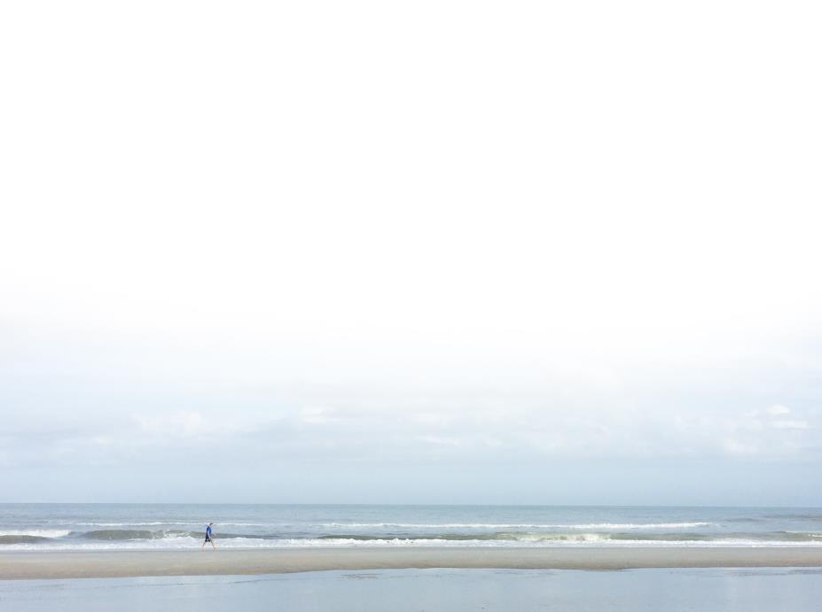
FOR MORE INFORMATION
U.S. Army Corps of Engineers | Jacksonville District
http://www.saj.usace.army.mil/
On Facebook www.facebook.com/JacksonvilleDistrict
On YouTube! www.youtube.com/JaxStrong
On Twitter www.twitter.com/JaxStrong
On Flickr www.flickr.com/photos/jaxstrong
Useful Restoration Sites:
www.evergladesrestoration.gov
www.sfwmd.gov

Slide 37
FOR MORE INFORMATION
U.S. Army Corps of Engineers | Jacksonville District
http://www.saj.usace.army.mil/
Deputy, Office of Small Business Programs Jacksonville
Ms. Beth Myers
Elizabeth.R.Myers@usace.army.mil
(904) 232-1150

